Slide 1
HACCP LEVEL 2
Training for
Food Professionals
Picture (food)
Logo

Slide 2
HACCP L2 Training
Logo
Aim: To summarise HACCP system and review the CCPs concepts
What will you learn today?
What is HACCP
What are the hazards in food
Regulations and Guidelines
7 Principles of HACCP
Determine CCPs
Food Hazards
Importance of HACCP for your company
CCPs at Food Industry site and products examples
Food Hazards
Prerequisite Programme
Food Safety Attitude
Corrective Actions / Action Plan
HACCP team
Responsibilities

Slide 3
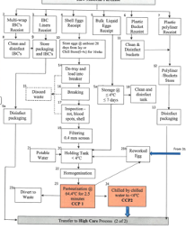
What is HACCP?
Logo
Hazard Analysis Critical Control Point is an international
food safety management system designed to prevent, reduce, or eliminate hazards in food. Instead of relying on inspecting finished food products, HACCP aims to identify and control risks during production.
Under Codex guidelines, HACCP is built upon 7 fundamental principles to ensure food safety management:
Conduct a Hazard Analysis
Determine Critical Control Points (CCPs)
Establish Critical Limits
Establish Monitoring Procedures
Establish Corrective Actions
Establish Verification Procedures
Establish Record-Keeping

Slide 4
Where does HACCP come from?
Logo
HACCP was originated in the 1960s through a collaboration between NASA, the U.S. Army Laboratories, and the Pillsbury Company. It was originally designed to guarantee 100% safe, crumb-free, and pathogen-free food for astronauts on early space missions.
1970s: The U.S. Food and Drug Administration (FDA) adopted HACCP principles for commercial canned food manufacturing.
1990s: International organisations, including the Codex Alimentarius Commission, adopted HACCP guidelines.
2000s: HACCP became a strict, legally mandated requirement across many regions (including the UK, through Regulation (EC) 852/2004)

Slide 5
What are the hazards in food?
Logo
A food hazard is something dangerous that could make food unsafe or unfit to eat.
The food business MUST identify hazards at each stage of the processing flow so they can be removed or reduced to safe levels.
There are three main types of food safety hazards:
physical - involving objects getting into food
chemical - involving chemical contamination
microbiological - involving harmful bacteria
Allergen – evolving the 12 allergens listed by the EU/UK government

Slide 6
Regulations
Logo
The Codex Alimentarius (Latin for "Food Code") is a collection of internationally recognised food standards, guidelines, and codes of practice established by the FAO and WHO.
Codex Alimentarius establishes the baseline food hygiene and safety standards that nations adopt to protect consumers and facilitate fair trade. As part of these standards, Codex mandates that food businesses implement a HACCP-based system.
While Codex defines what the general requirements are, HACCP acts as the practical how-to framework to identify, evaluate, and control food safety hazards
HACCP was introduced by Regulation (EC) No 852/2004 on food hygiene. This law made HACCP-based procedures mandatory for food businesses in the UK.
EHO (Environmental Health Officer) can fine the business or shut the company down if the HACCP plan is not implemented.

Slide 7
The 7 HACCP Principles
Logo
Conduct a Hazard Analysis: Identify biological, chemical, or physical hazards that could make food unsafe.
2. Determine Critical Control Points (CCPs): Locate the specific steps in the process where controls can be applied to prevent or eliminate hazards.
3. Establish Critical Limits: Set maximum or minimum values (e.g., temperatures, cooking times) that must be met to ensure the CCP is under control.
4. Establish Monitoring Procedures: Create systematic testing or observations to ensure a CCP remains within its critical limits.
5. Establish Corrective Actions: Define the specific steps taken when monitoring shows a CCP is deviating from its critical limits.
6. Establish Verification Procedures: Apply tests, audits, and evaluations to confirm the HACCP system is working effectively.
7. Establish Record-Keeping: Maintain logs, charts, and documents necessary to prove that safety controls were executed correctly.

Slide 8

Determine Critical Control Points (CCPs)
Logo
The second principle of the HACCP system. It identifies the specific steps in a process where a control measure can be applied to prevent, eliminate, or reduce significant safety hazards to acceptable levels
This step requires a systematic approach, often utilising expert knowledge and a structured decision tree. The standard method relies on the following steps:
Design a processing flow
Perform a Thorough Hazard Analysis in each step
Apply a CCP Decision Tree
Determine the CCPs
Categorise by Type of Control (chemical, physical, biological, allergen)
Establish Critical Limits and Monitoring

Slide 9

Logo
Can you tell me which CCPs you have in your work area?
If not, do you know how many CCPs your company handles?

Slide 10
Importance of HACCP for D.Wise
Logo
HACCP helps the company understand the potential risks associated with food safety in the production line.
2. Helps the company to identify, evaluate, and control potential hazards to prevent foodborne illnesses.
3. Helps the company to add necessary controls in place to tackle the potential risks.
4. It protects consumer health, prevents foodborne illnesses and allergic reactions.
5. Maintains consumer confidence in the quality and safety of the brand.
6. Protects the business reputation as the HACCP is well implemented and monitored, avoiding recalls from the market.
7. Guide the company on how to comply with the law to keep Food Safety at the high level.
8.The company cannot trade without a HACCP system implemented.

Slide 11
CCP: Critical Control Point
Examples in Food Production
Logo
Physical hazards
Pasteuriser
Scrambled Egg
Muffin
Kill pathogens
Pasteuriser
Scrambled Egg
CCP 1
In-line Filtering 1000 microns
CCP 2 – Liquid and Scrambled Egg
Pasteuriser: > 72 °C for 2.5 min.
Scrambled Egg: Cooked at>88 °C for 20 mins.
CCP3 – Cooking Egg Omelette: Cooked at>86 °C for 20 mins.
Avoid micro-grown
- Cooking Scrambled Egg
- Cooking Muffin
Physical hazards
Metal Detection
- IQF
- Muffin
CCP3 – Chilling Scrambled Egg
Chilled < 8 °C within 90 minutes.
CCP4 – Chilling Egg Omelette
Chilled < 8 °C within 90 minutes.
CCP 2
Egg Muffin Metal Detection
CCP 4
IQF Scrambled Egg Metal Detection

Slide 12
Monitoring
Logo
CCP Monitoring
  To monitor Critical Control Points (CCPs) effectively in a HACCP system, we need to regularly observe control measures to ensure they remain within established critical limits.
  Our monitoring system MUST match the production records and reflect the immediate results.
  The Technical/Quality team must be informed immediately in case of CCP deviations
  A Non-Conformities/Incident Report MUST be recorded in case of deviation.
  Environmental Monitoring
  Environmental monitoring is important for controlling potential pathogens and indicates adherence to Good Manufacturing Practices (GMP) and housekeeping. Routine testing for generic organisms must be taken regularly to eliminate and reduce contamination to an acceptable level.
  The frequency of testing is based on risk, which will be determined by a Risk Assessment managed by the HACCP Team.

Slide 13
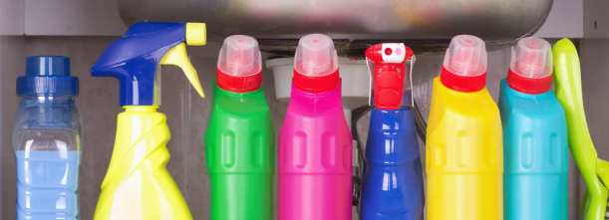
To remember – Hazard: Chemical
Logo
  Sanitise Surfaces and Equipment: Clean worktops and equipment with the chemical from the approved suppliers, following the cleaning cards (CIC’s), ensuring the correct concentration and contact time, and using the appropriate cleaning tools. Sponges and wired pads are not permitted.
Chemical approved supplier:
Tell me which chemical suppliers your company has approved

Slide 14

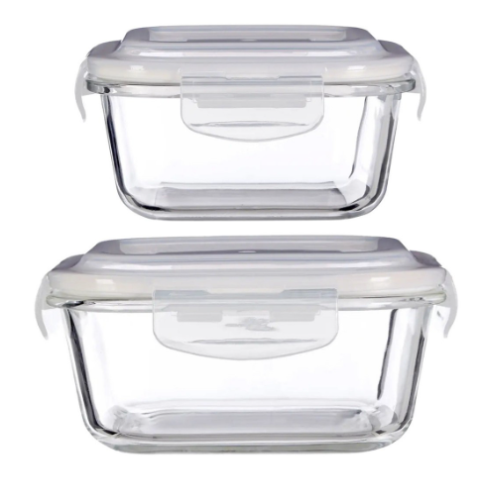
To remember – Hazard: Physical
Logo
Physical Hazards are any foreign object or naturally occurring extraneous matter that unintentionally ends up in food.
They can carry significant risks to consumers, such as choking, cuts, internal tissue damage and broken teeth
Examples of Physical Hazards: Glass, a piece of plastic, hair, insects, bugs, plaster, screws, etc.
Please report any broken glass in production
No glass in the canteen

Slide 15
To remember – Hazard: Allergen
Logo
By law, food businesses must clearly indicate if any of the 14 major food allergens are used
as ingredients in their products. These 14 allergens are:
Celery: stalks, leaves, seeds, and root (celeriac).
Cereals Containing Gluten: wheat (spelt, Khorasan), rye, barley, and oats.
Crustaceans: crabs, lobster, prawns, and scampi.
Eggs: baked goods, mayonnaise, and sauces.
Fish: fish sauces, relishes.
Lupin: seeds and flour can be used in some breads and pastries.
Milk: milk, butter, cheese, cream.
8. Molluscs: mussels, oysters, squid, and escargot.
9. Mustard: liquid mustard, powder, and seeds.
10. Peanuts: also called groundnuts.
11. Sesame Seeds: burger buns with sesame, salads, and in hummus.
12. Soybeans: tofu, edamame, miso, and soy sauce.
13. Sulphur Dioxide and Sulphites: food preservatives, dried fruits, wine, and meat products
14. Tree Nuts: Includes almonds, hazelnuts, walnuts, cashews, pecans, Brazil nuts, pistachios, and macadamia nuts

Slide 16
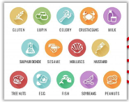
To remember – Hazard: Allergen
Logo
Allergens on (company) Site:
Cereals Containing Gluten: Breakfast Egg Muffin
Eggs: all (company) products
Fish: Smoked Salmon – Egg Muffin
Milk: Scrambled Egg, Cheese muffin
Sulphur Dioxide and Sulphites: Breakfast Egg Muffin
Can you name the allergens you handle in the workplace?

Slide 17

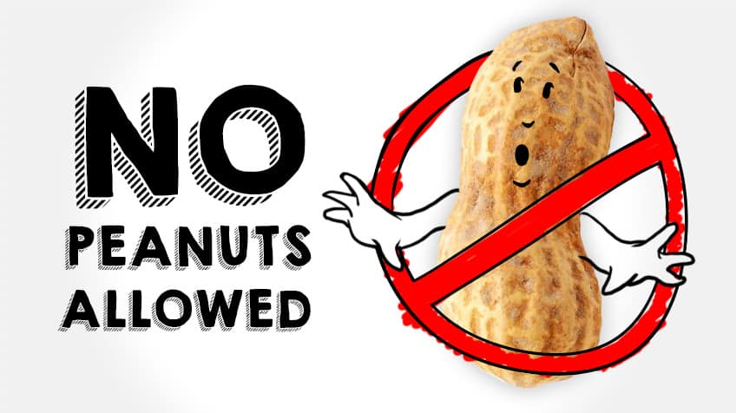
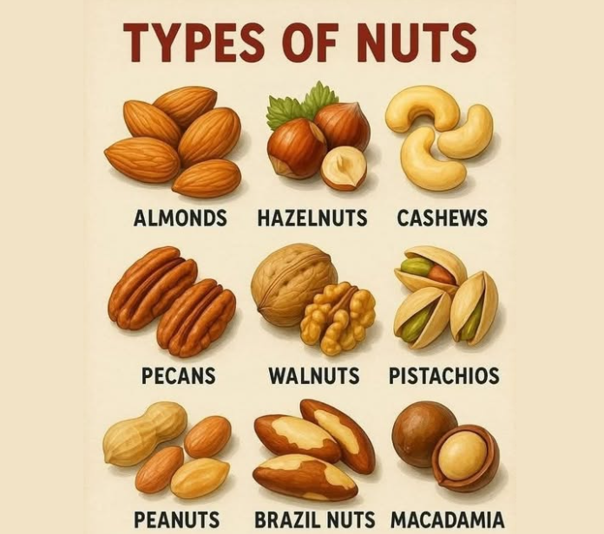


Nut-free site.
We do not bring food that contains nuts when we come to work.
To remember – Hazard: Allergen
Logo
It is not allowed to bring products containing nuts to the site, such as Peanuts, Almonds, Hazelnuts, cashews, pecans, walnuts, pistachios, Brazil nuts, macadamia, and sesame.

Slide 18
To remember – Hazard: Biological
Logo
Examples of Key Performance Indicator:
Egg (liquid/Scrambled/Plain Muffin)
Test | Frequency | Target | Reject
Total Viable Count | Per Batch | <5,000/g | 10,000/g
Presumptive Enterobacteriaceae | Per Batch | <20/g | 20/g
Presumptive Staph. Aureus | Per Batch | <20/g | 20/g
Salmonella sp | Per Batch | Absent in 25g | Present in 25g
Listeria sp | Per Batch | Absent in 25g | Present in 25g
Presumptive Bacillus Cereus | Per Batch | <100/g | >500/g
Can you name 3 examples of a bacteria/virus you need to avoid the most in your workplace?

Slide 19
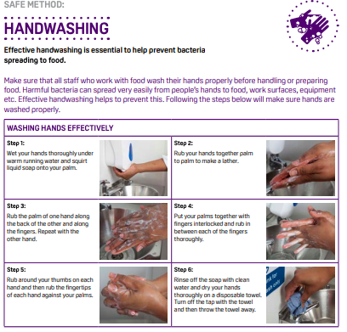
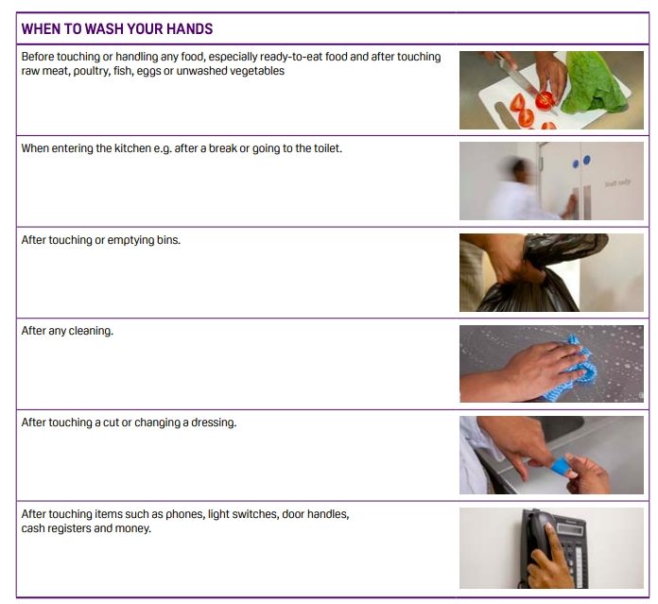
To remember – Personal Hygiene
Logo
Hands Washing

Slide 20
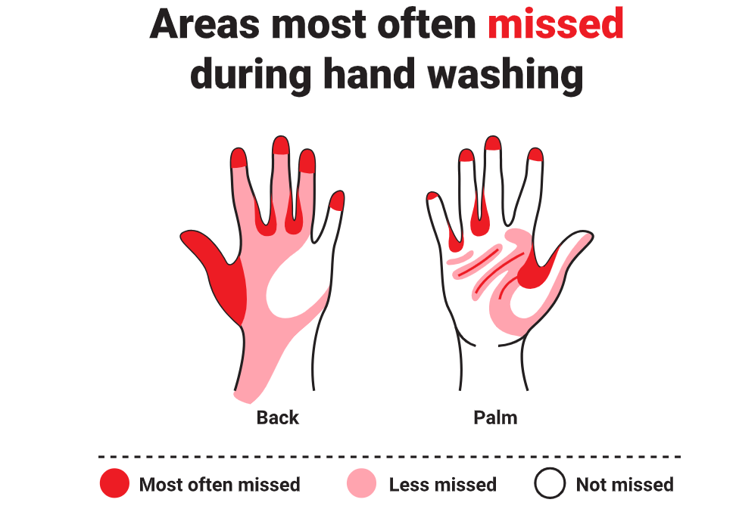
To remember – Personal Hygiene
Logo
Hands Washing

Slide 21
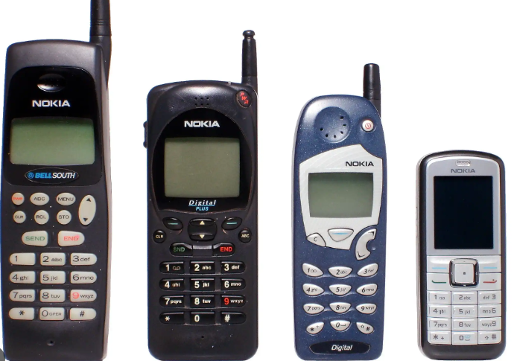


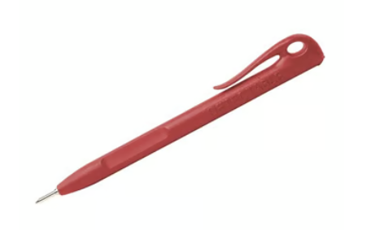
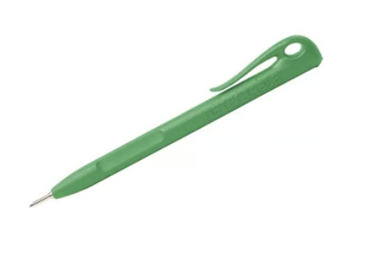
Sanitise goods before entry in the HC and HR areas
Phone is permitted only for authorised personnel
It MUST be sanitised before entering the HC and HR areas.
For tablets, pens, and any other materials that cannot be wet, use the sanitised wipes before entering the HC and HR areas.
Low Risk areas
High-Care areas
High-Risk areas
Green Pen: High-Risk area
Red Pen: High-Care areas
Blue Pen: Low-risk areas

Slide 22
PRE-REQUISITE PROGRAMME
Logo
Prerequisite Programs (PRPs) are the foundational hygiene, environmental,
and operational practices required before implementing a HACCP (Hazard Analysis and Critical Control Point) system. They establish a safe operating environment by managing general risks, so the HACCP team can focus on specific, critical hazards. PRPs key points:
1. Cleaning and Sanitation: Procedures for regularly cleaning and sanitising surfaces, equipment, and utensils.
2. Personal Hygiene: Requirements for handwashing, protective clothing, and health monitoring of employees.
3. Pest Control: Preventative measures and regular inspections to keep the production area free of pests.
4. Equipment and Premises Maintenance: Keeping facilities and machinery in good working order to prevent contamination or breakdowns.
5. Supplier Control: Ensuring ingredients are sourced from reputable suppliers that meet safety standards.
6. Allergen Management: Segregation and handling rules to protect customers from cross-contact.
7. Staff Training: Ensuring all workers understand basic food hygiene and their role in safety.

Slide 23
Logo
Food Safety attitude – food professionals
  Cross-contamination: strictly separate raw and ready-to-eat foods. Key steps include using distinct
  colour-coded chopping boards, knives, and gloves. Washing your hands with soap and water, and sanitising surfaces before and after preparing meals.
  Separate Equipment: such as knives and chopping boards; use the same equipment on different schedules; and always clean and sanitise after use, including between recipes containing allergens.
  Safe Storage: Keep raw food separated from the ready-to-eat food. Meat separate from vegetables, and allergen products separate from non-allergen products. Keep the ingredients in sealed containers at all times (frozen and defrosted).
  All the ingredients MUST have a label containing:
  Ingredient name:
  Date of defrosted (or date of open)
  Ube by date
  Operator name
  Hand Hygiene: Wash your hands with warm, soapy water for at least 20 seconds before and after handling raw foods.

Slide 24
Corrective Actions / Action Plan
  Corrective actions are steps to bring the process back under control, determine the cause of the
  deviation, and prevent recurrence.
  For example, if a cooking temperature falls below the critical limit in the Scrambled Egg production (< 86 °C), corrective actions MUST be taken immediately to bring the process back under control, also determine the cause of the deviation, and prevent recurrence.
  The quality tool PDCA can support the HACCP team in reviewing the process and reassessing the HACCP system to prevent recurrence of production deviations.
  Plan: Conduct your hazard analysis, identify Critical Control Points (CCPs), set critical limits, and establish monitoring procedures.
  Do: Implement the HACCP plan, train staff, and execute your control measures and operational routines.
  Check: Monitor the CCPs, review temperature logs, and conduct internal audits to ensure safety protocols are functioning as intended.
  Act: Take corrective actions when deviations occur, standardise successful improvements, and update the HACCP plan to prevent future issues

Slide 25
HACCP TEAM
A HACCP team is a multidisciplinary group responsible for developing, implementing, and maintaining a food safety management system.
The HACCP team is responsible for identifying hazards, establishing control measures, and ensuring compliance with food safety regulations to keep food safe.
Can you name 3 members of your company’s HACCP team?

Slide 26
Responsibilities
Immediate Response Actions
  Put the product ON-HOLD if the product is out of spec. The quality team will investigate, create an action plan and decide if the product will be released for sale.
  Clear Communication
  Communicate with production and technical staff to ensure actions and effective risk control. Out-of-specification circumstances MUST be reported immediately to the technical/quality team.
Employee Responsibilities
  Employees must follow the HACCP steps, the hygiene rules, use equipment properly, clean as trained, and report issues to prevent contamination.
Shared Food Safety Accountability
  Food safety depends on consistent, responsible behaviour from all staff, and the company, not just the quality team.
  Everyone in the business can be held legally responsible for a foodborne illness.

Slide 27
Let’s keep the product safe and our strong reputation
Logo

Slide 28
Reference
Food Safety Agency: Hazard Analysis and Critical Control Point (HACCP) | Food Standards Agency
CIEH: HACCP training | CIEH Training Programmes
UK Government: Make an HACCP food plan - GOV.UK
Codex Alimentarius: Home | CODEXALIMENTARIUS FAO-WHO

Slide 29
HACCP L2 Training – Assessment
Knowledge before – from 0 – 5:
Knowledge after training – from 0 – 5:
1. What is the main purpose of HACCP?
a) To inspect finished food products only
b) To prevent, reduce, or eliminate food safety hazards
c) To increase production speed
2. Which of the following is NOT a type of food hazard?
a) Physical
b) Financial
c) Microbiological
3. What is the required pasteurisation condition for liquid egg?
60°C for 10 minutes
>72°C for 2.5 minutes
100°C for 1 minute
4. What is the requirement for Scrambled Egg CCP 2?
86°C for 10 minutes
>88°C for 20 minutes
100°C for 1 minute
5. What is the requirement for Egg Muffin CCP 3 and
86°C for 10 minutes
>86°C for 20 minutes
100°C for 1 minute
6. Which action helps prevent cross-contamination?
A) Using the same tools for all foods
B) Colour-coding tools and cleaning properly
C) Ignoring cleaning schedules
7. Which of the following is a good personal hygiene practice?
A) Not washing hands regularly
B) Wearing jewellery during production
C) Washing hands and changing gloves before starting the next recipe
8. What should you do if allergen contamination is suspected?
A) Ignore it
B) Put the product on hold and report it to the manager/technical staff
C) Sell the product quickly
9. Who is responsible for food safety and allergen control?
A) Only the manager
B) Only the quality team C) Everyone
10. Write in the back of this page: which allergen we have on site and what you should do to avoid cross-contamination.
Learner Name:
Title:
Date: Signature_____________

